Slide 1

Sorting
Sorting takes an unordered collection and makes it an ordered one.

Slide 2

Bubble Sorting

Slide 3
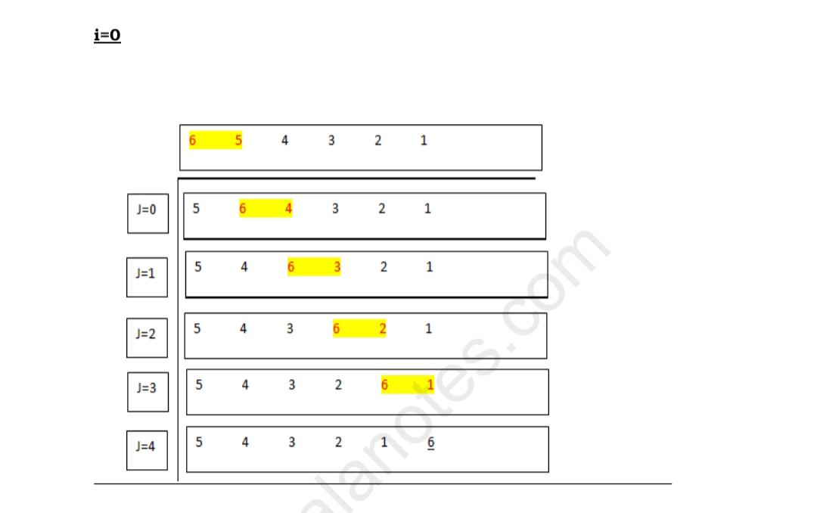
Bubble Sorting

Slide 4
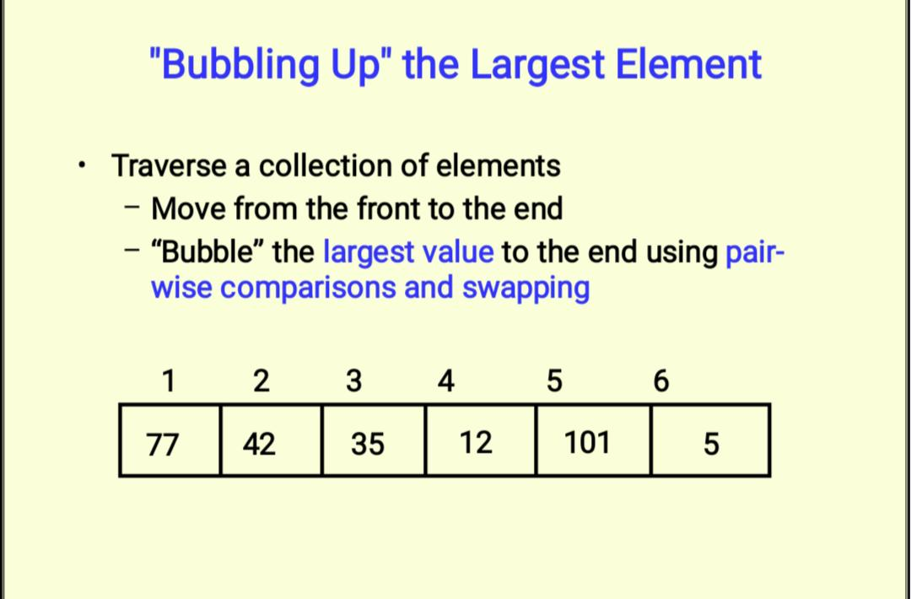
Bubble Sorting

Slide 5
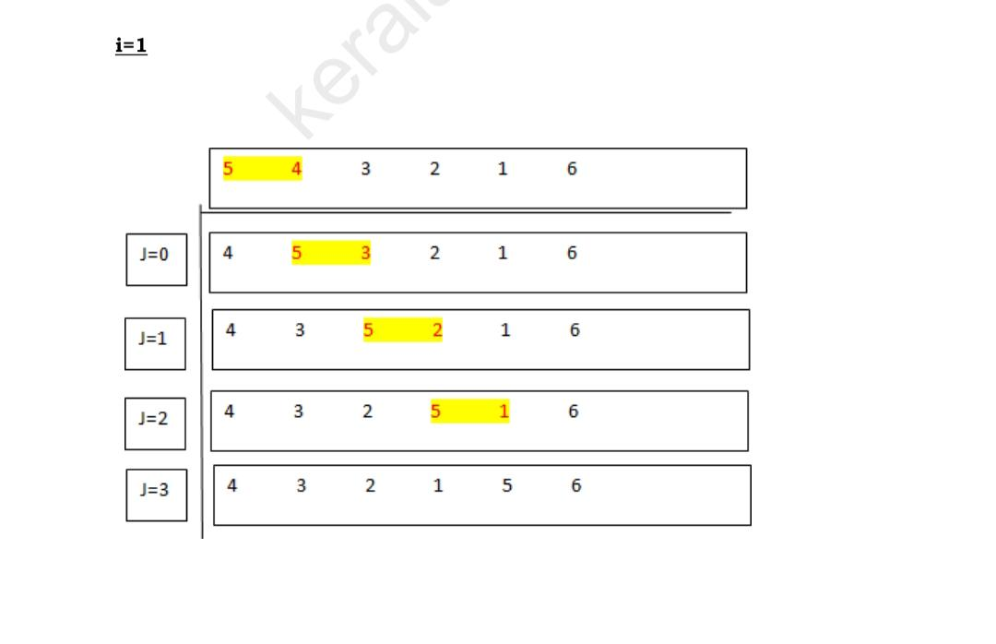
Bubble Sorting

Slide 6
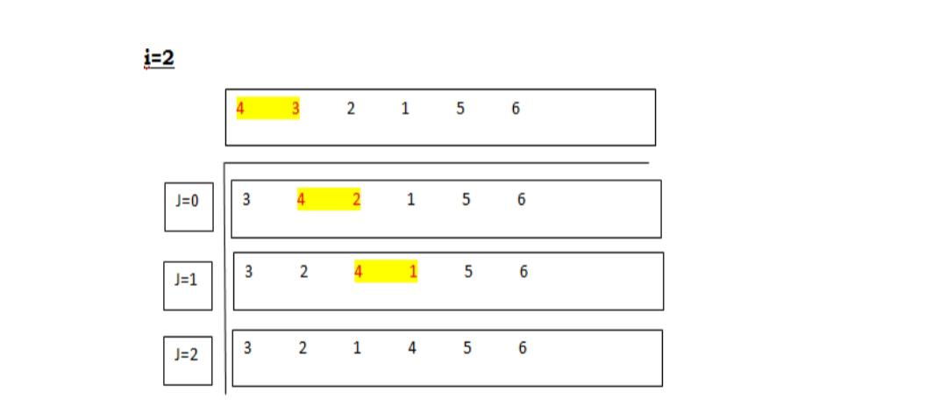
Bubble Sorting

Slide 7
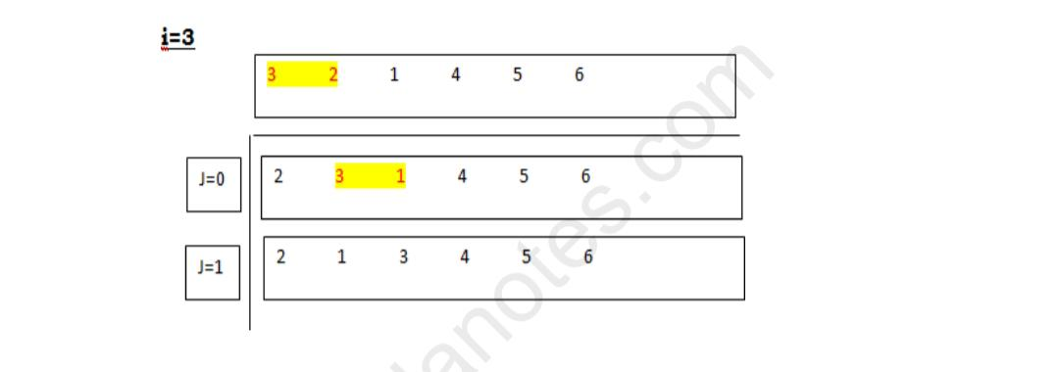
Bubble Sorting

Slide 8
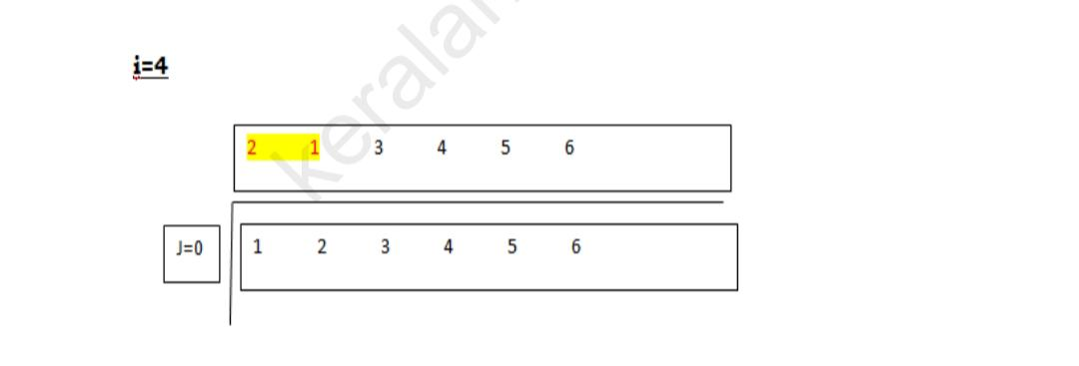
Bubble Sorting

Slide 9
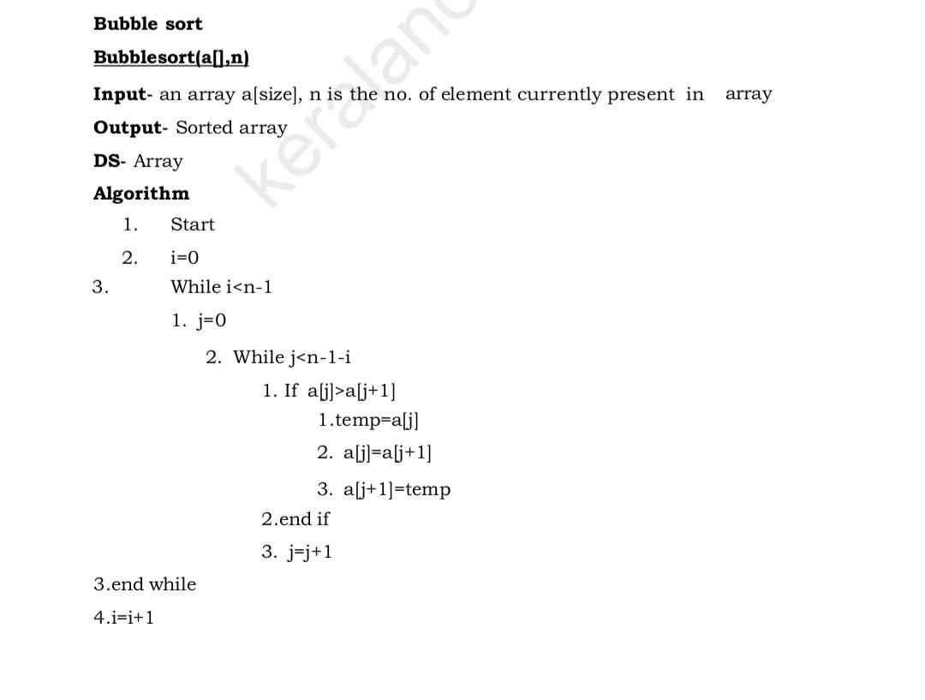
Bubble Sorting

Slide 10
Bubble Sorting
First element is compared with second element. If first one is greater thsecond element then swap each other.
Then second element is compared with third element . If second element is greater than third element then perform swapping.
This process is continued until the comparison of (n-1)th element with nth element. These process continues (n-1) times

Slide 11
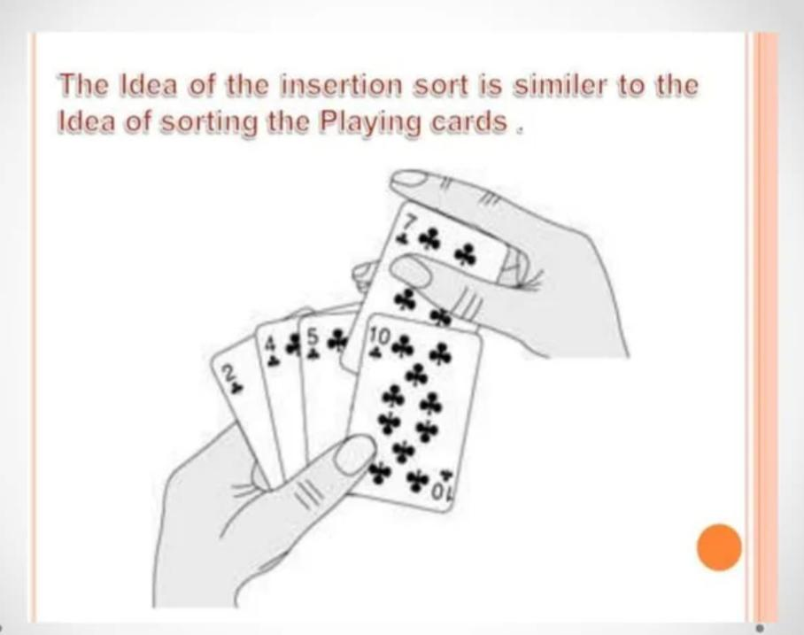
Insertion sorting

Slide 12
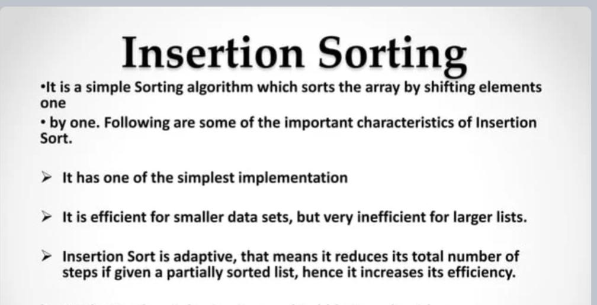
Insertion sorting

Slide 13
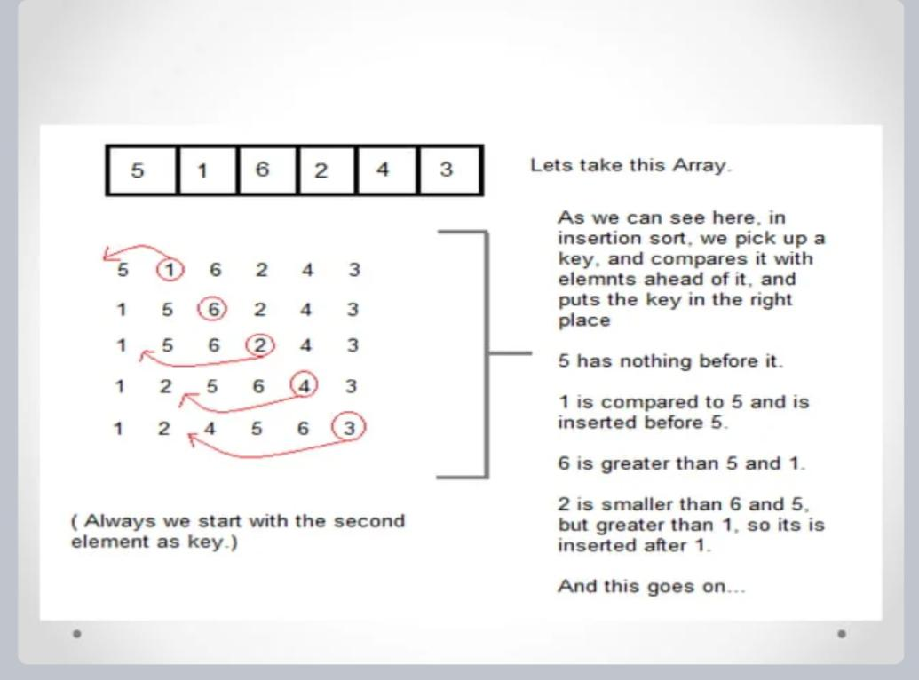
Insertion sorting

Slide 14
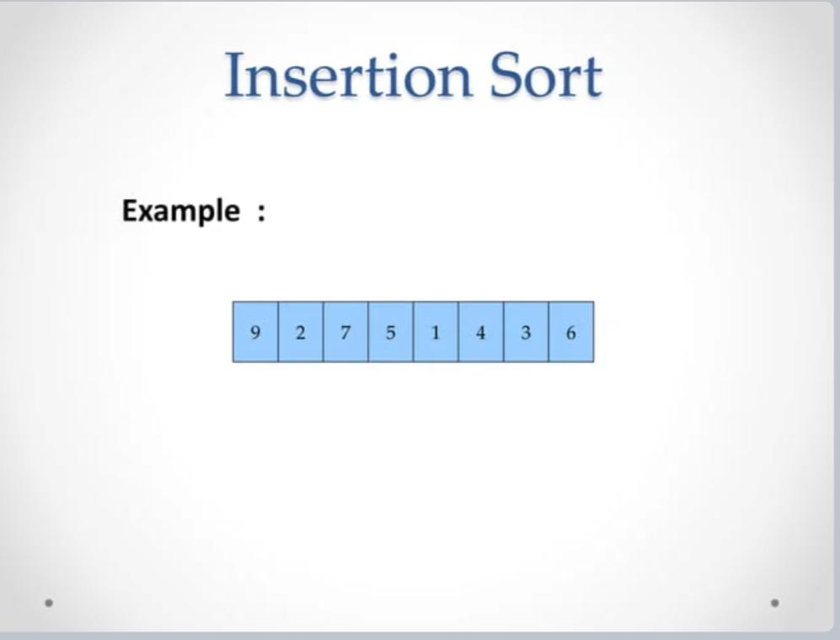

Slide 15
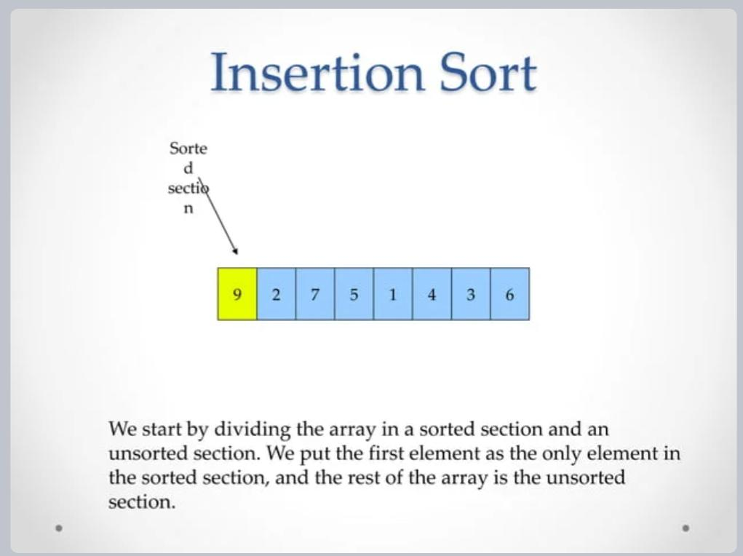
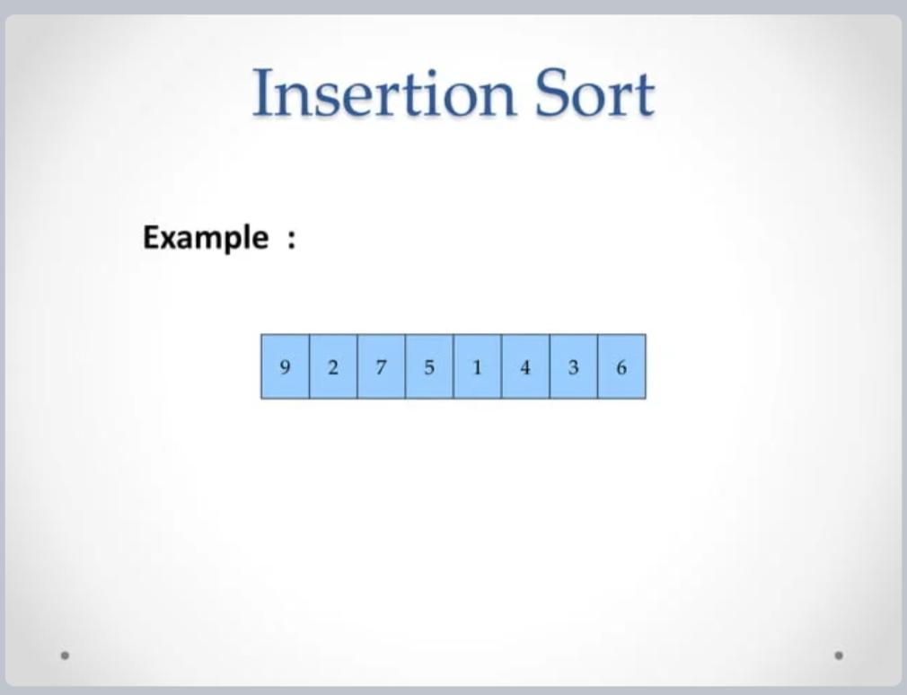

Slide 16
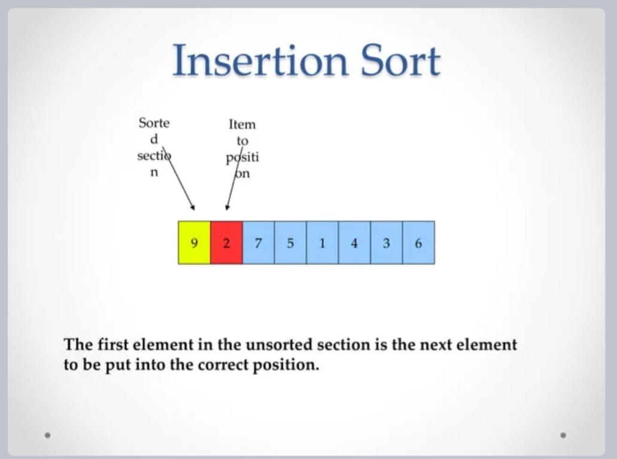

Slide 17
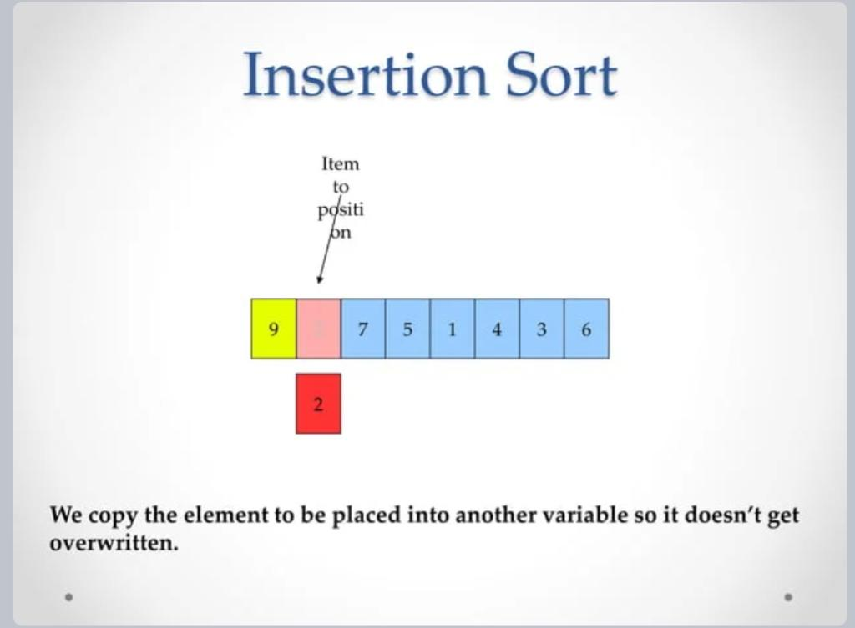

Slide 18
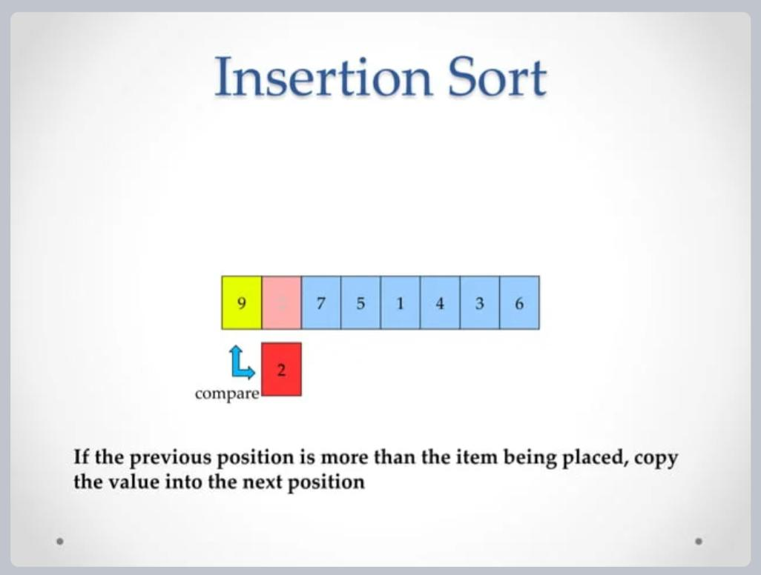

Slide 19
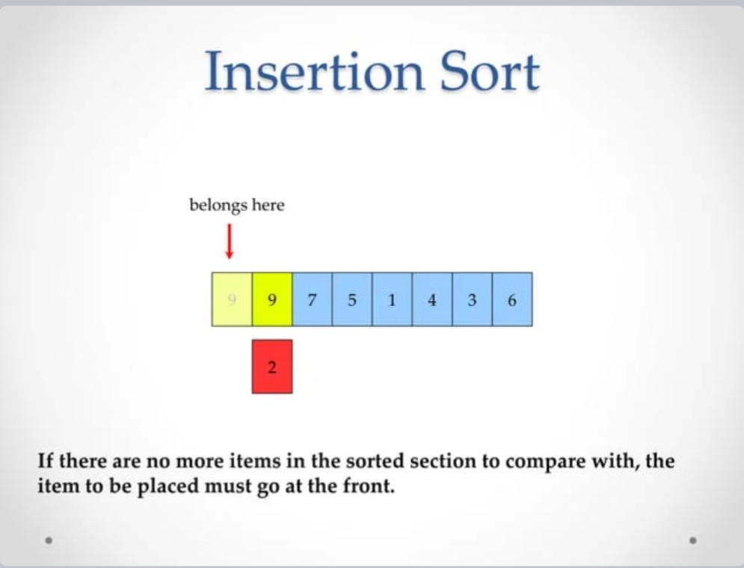

Slide 20
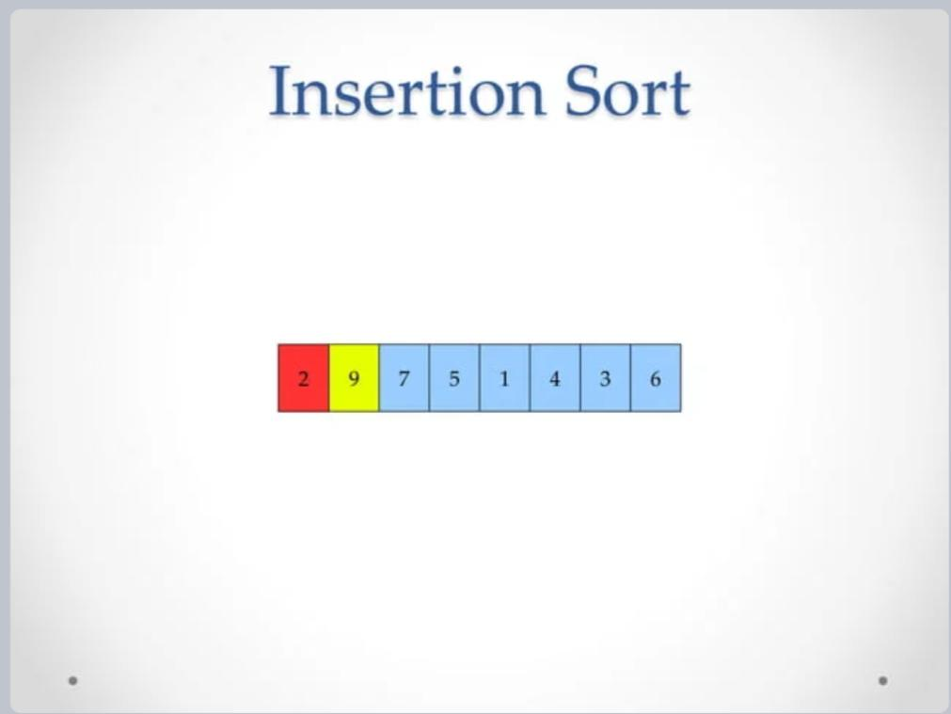

Slide 21
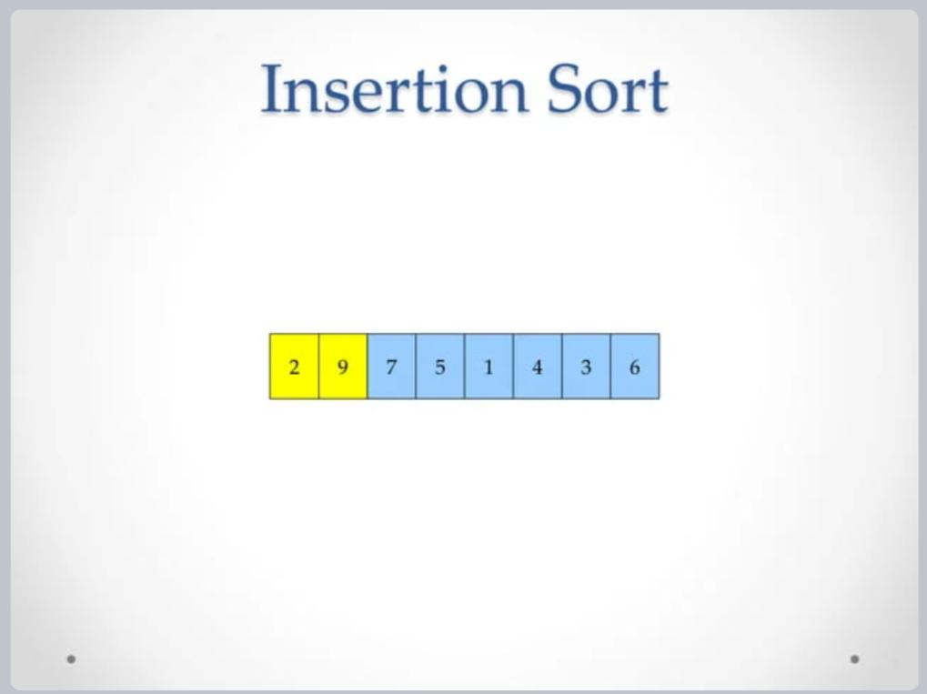

Slide 22
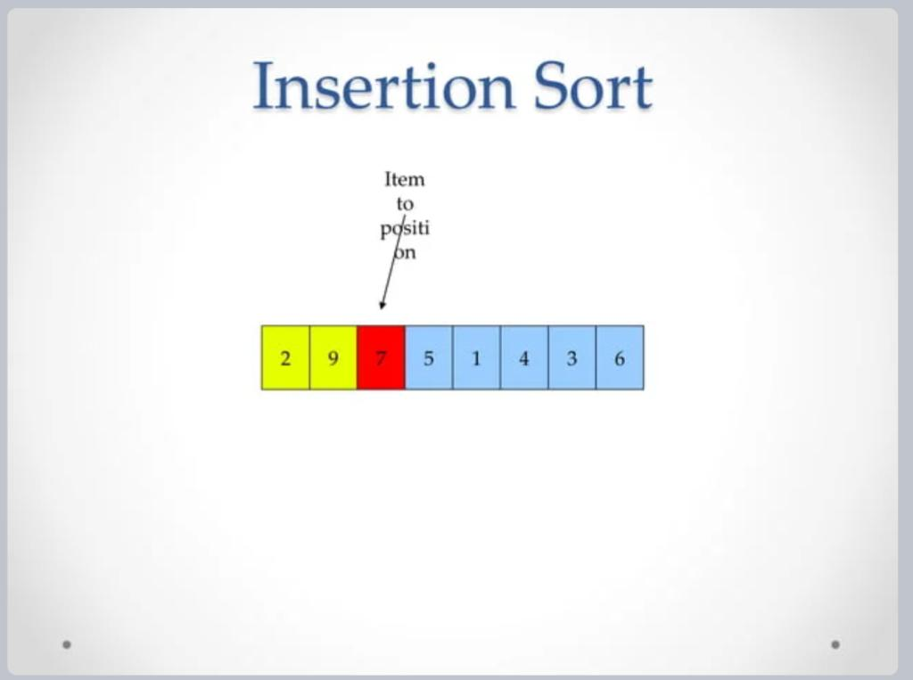

Slide 23
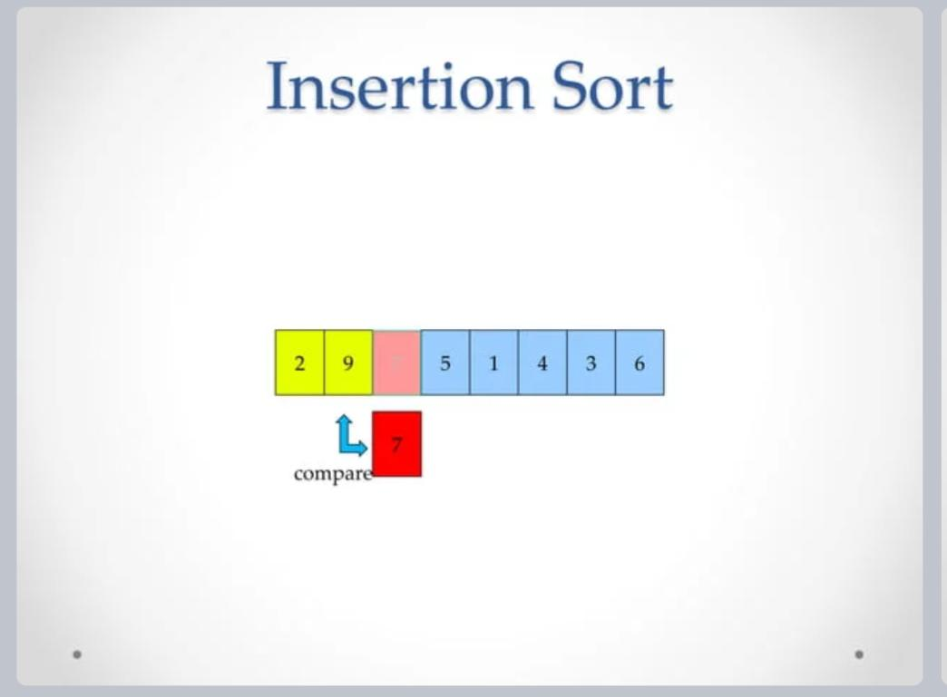

Slide 24
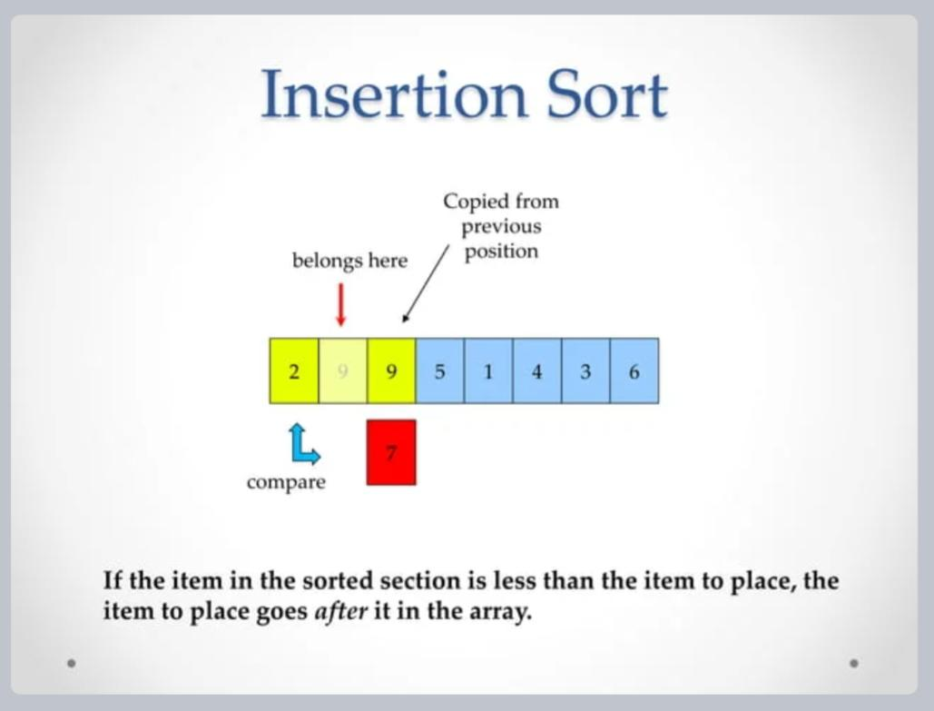

Slide 25
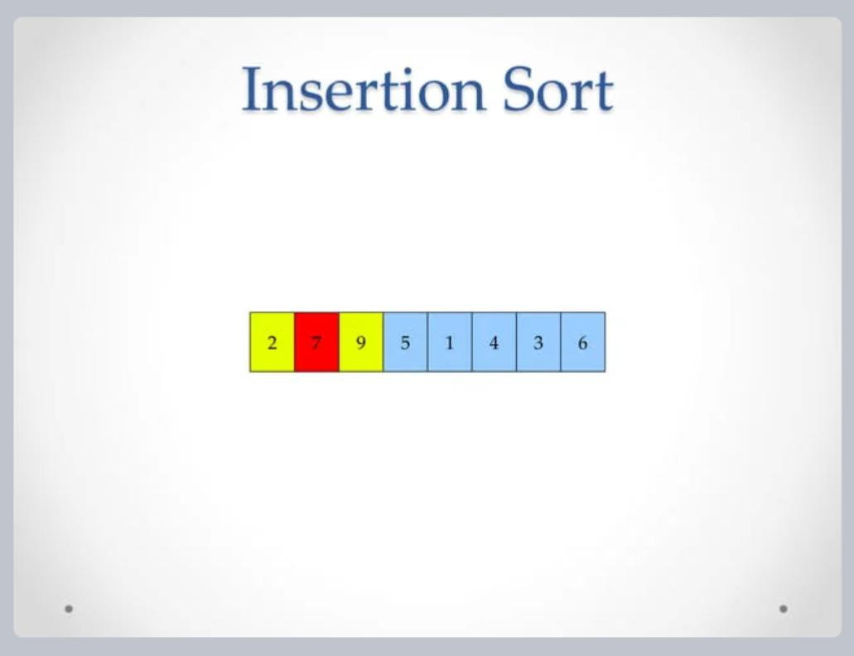

Slide 26
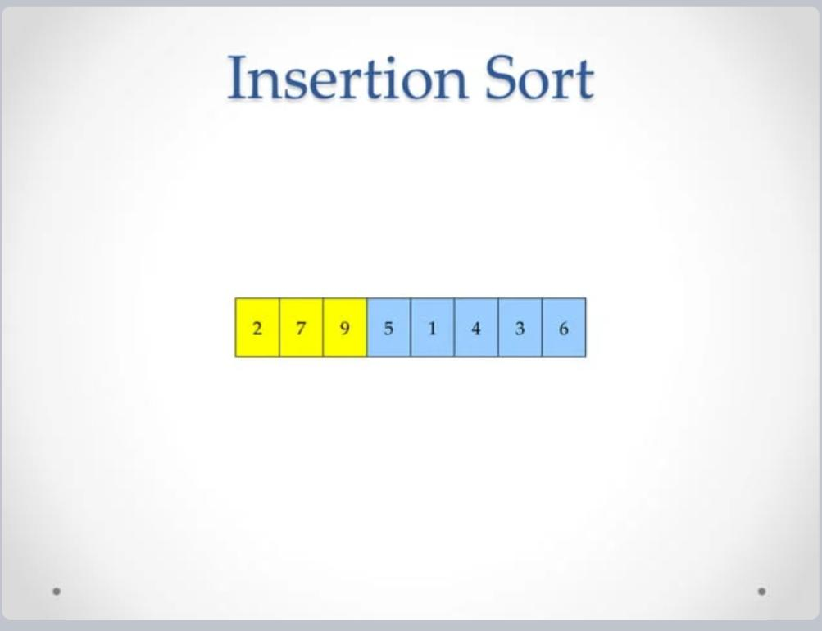

Slide 27
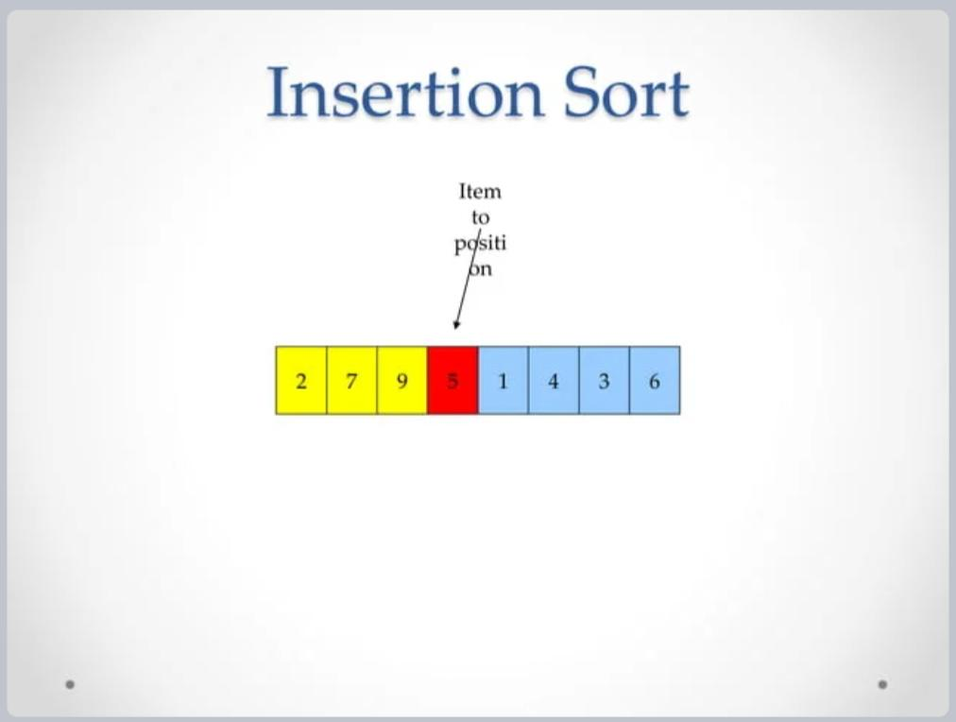

Slide 28
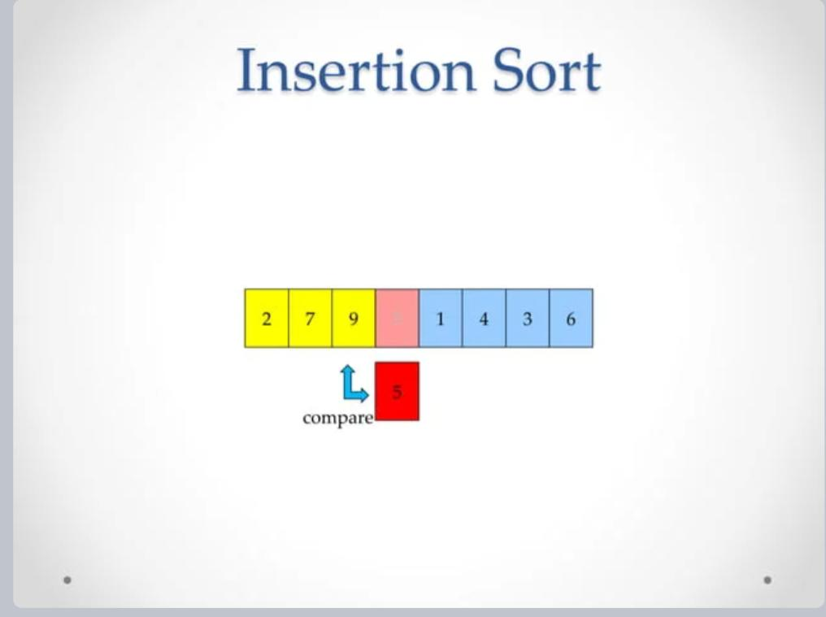

Slide 29
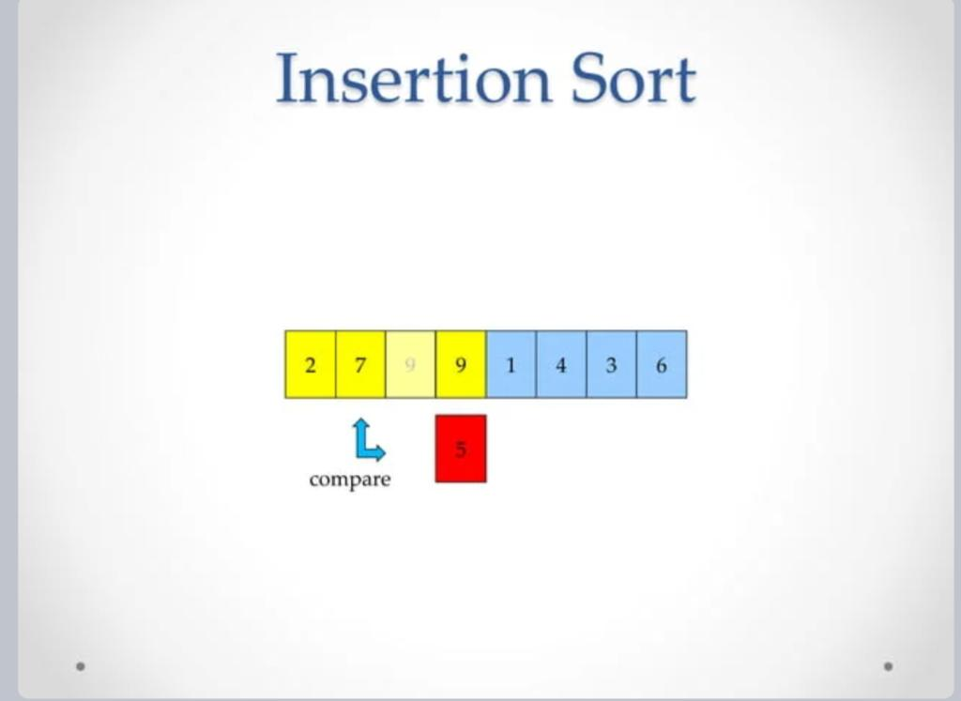

Slide 30
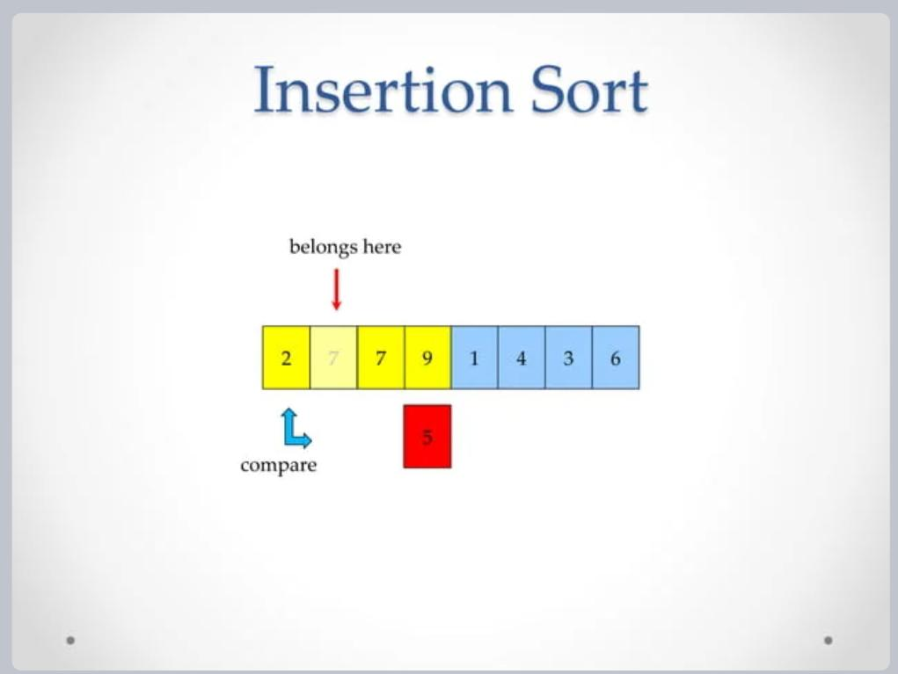

Slide 31
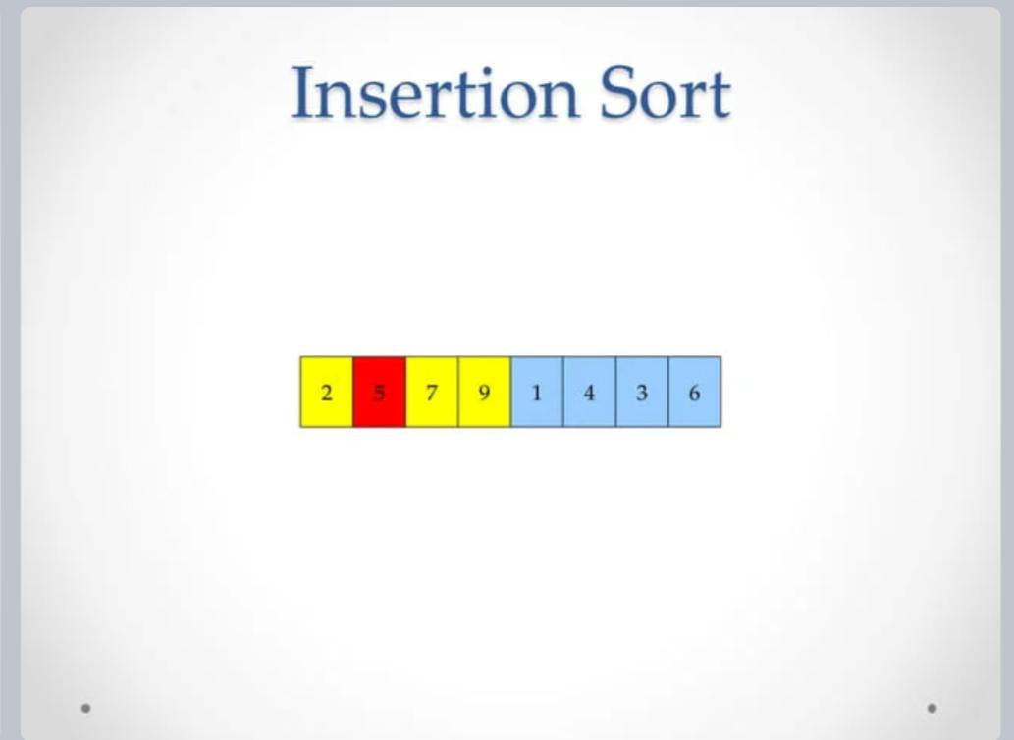

Slide 32
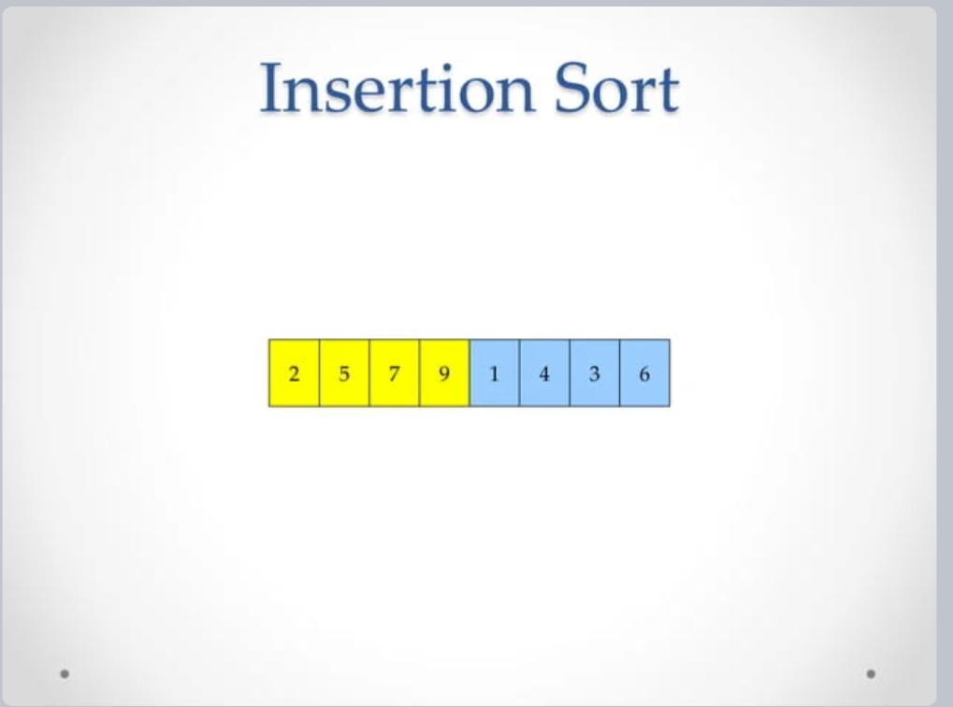

Slide 33
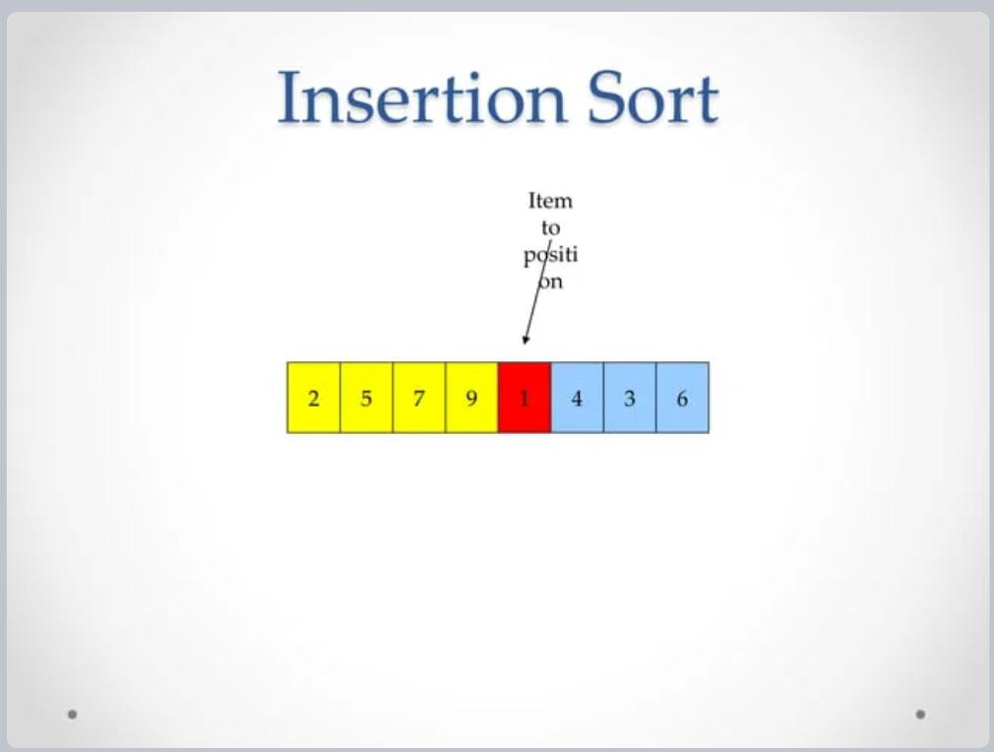

Slide 34
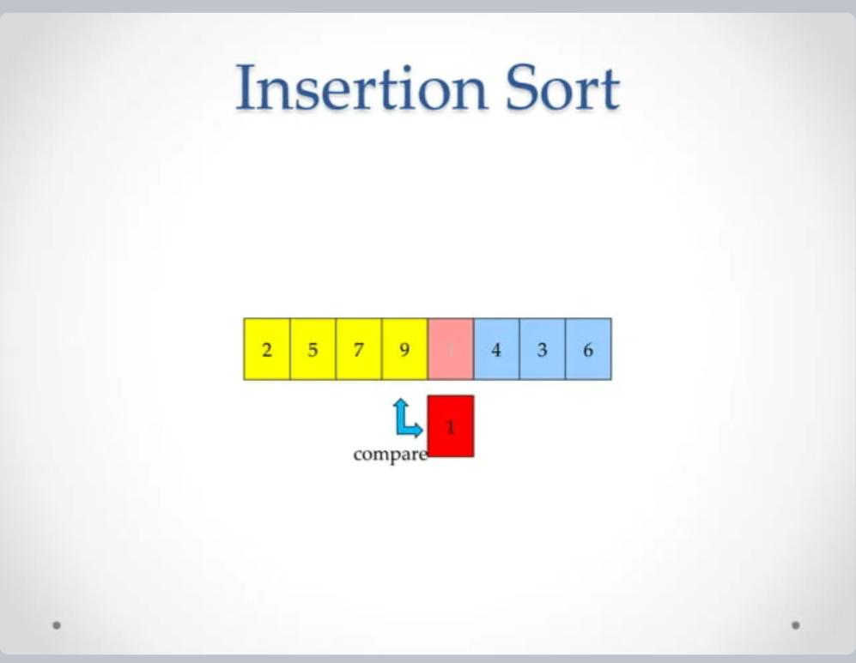

Slide 35
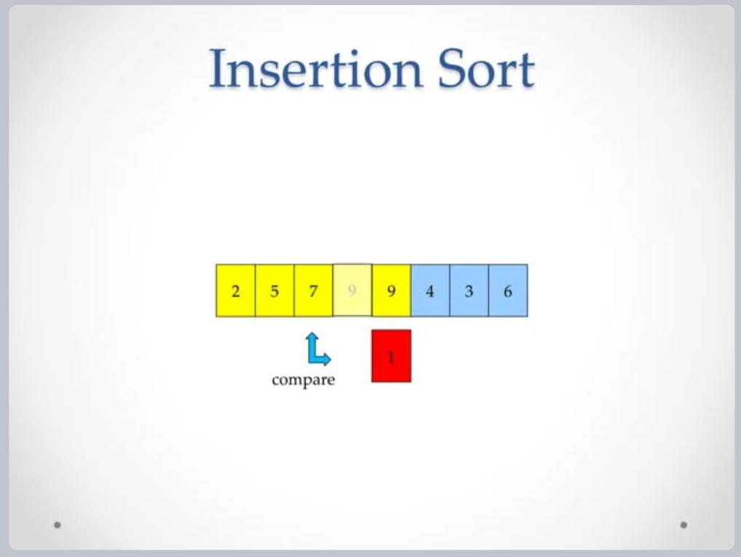

Slide 36
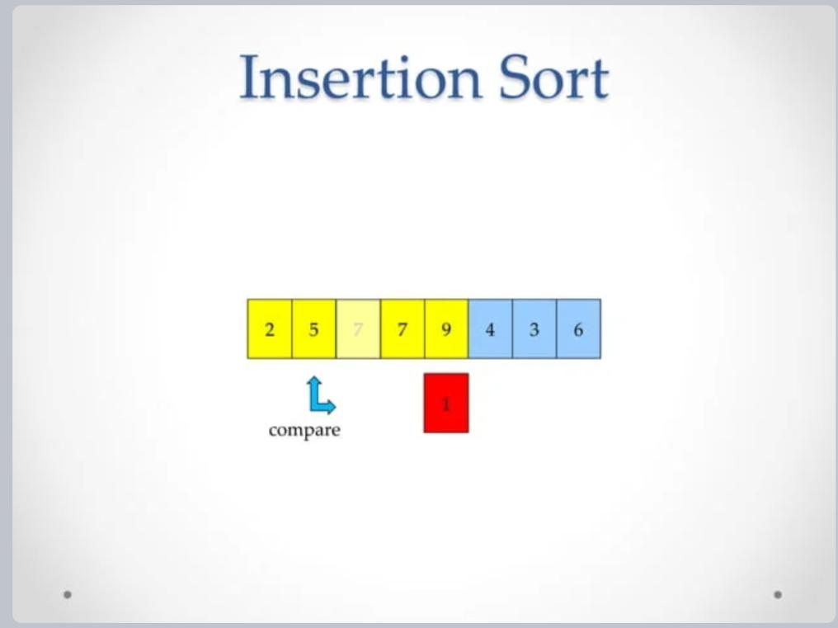

Slide 37
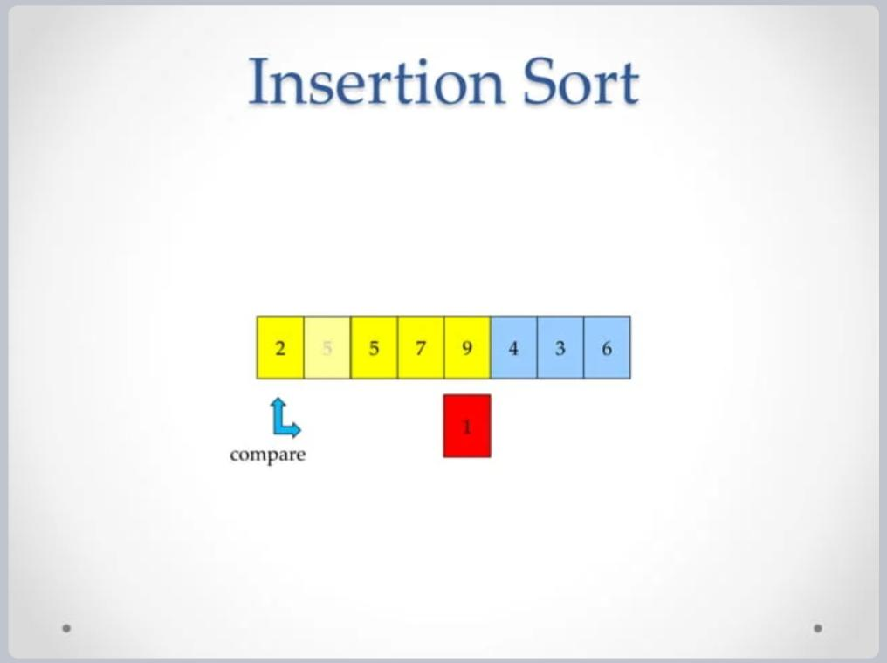

Slide 38
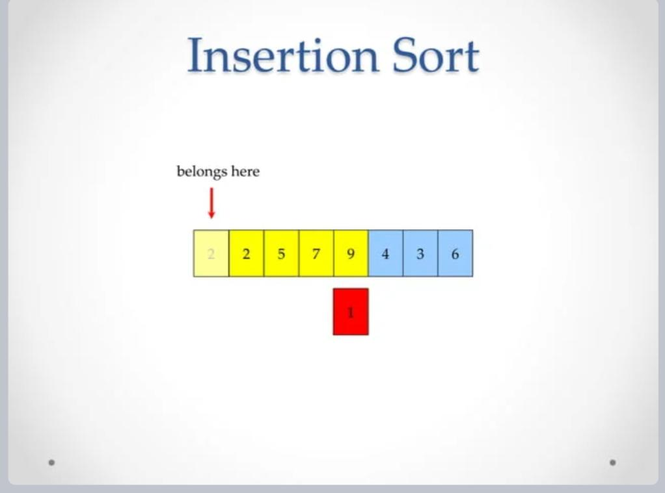

Slide 39
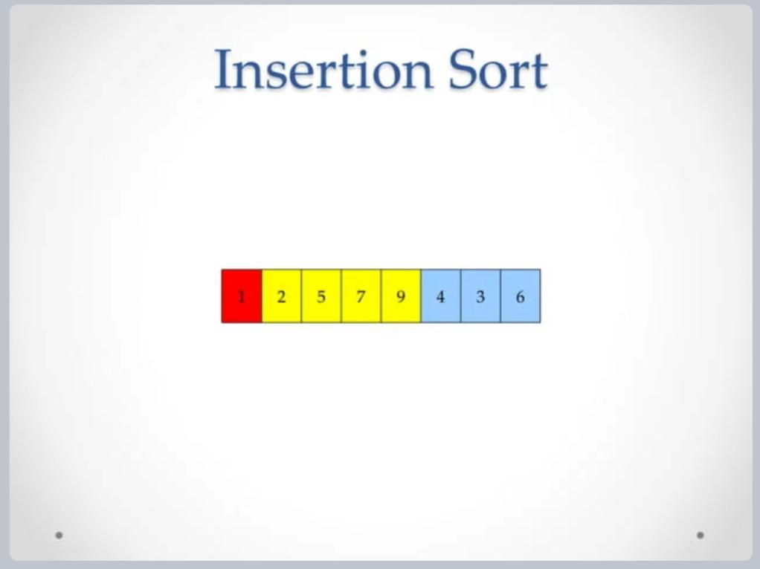

Slide 40
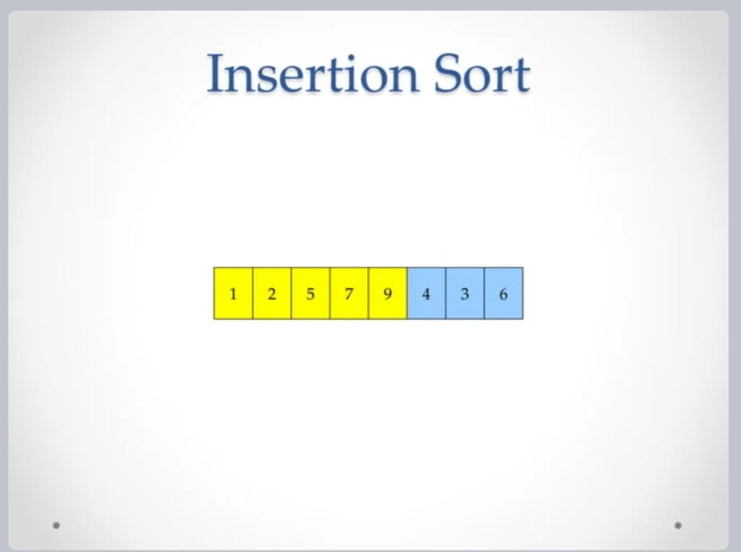

Slide 41
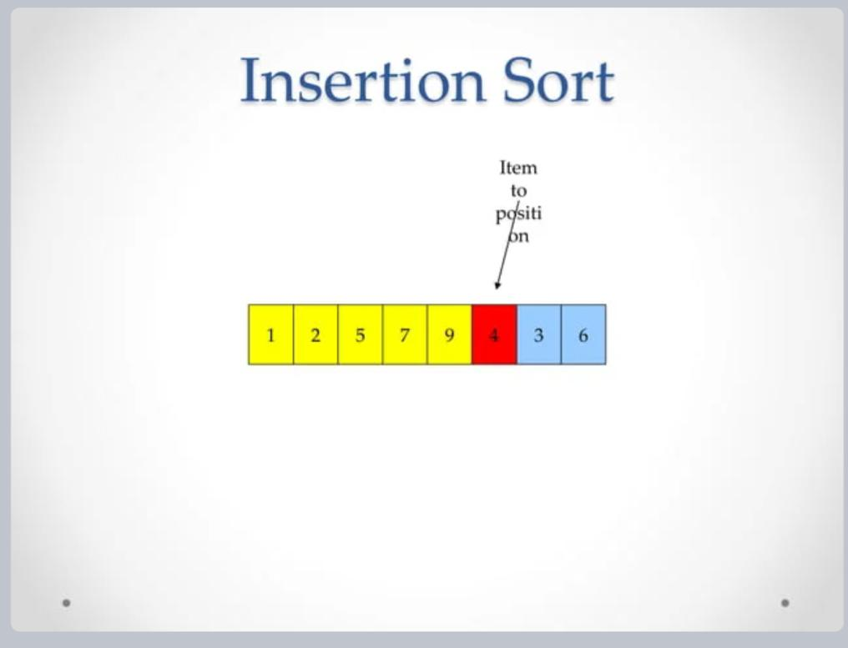

Slide 42
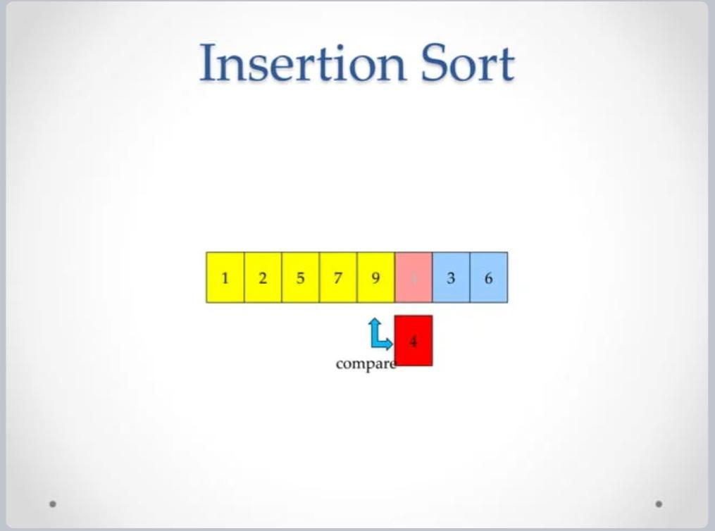

Slide 43
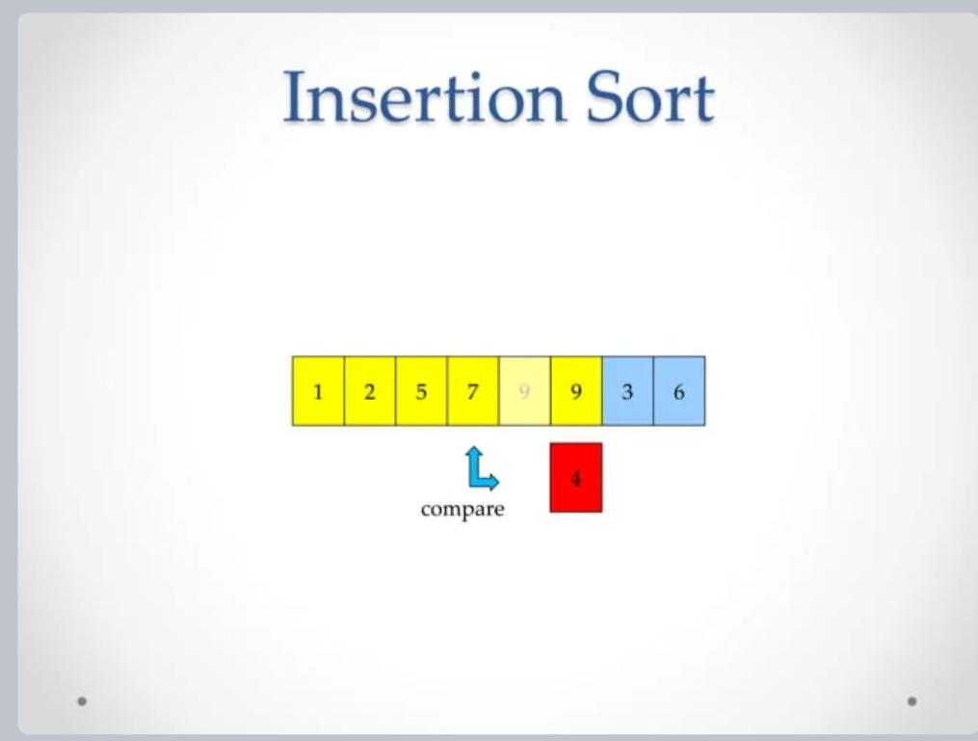

Slide 44
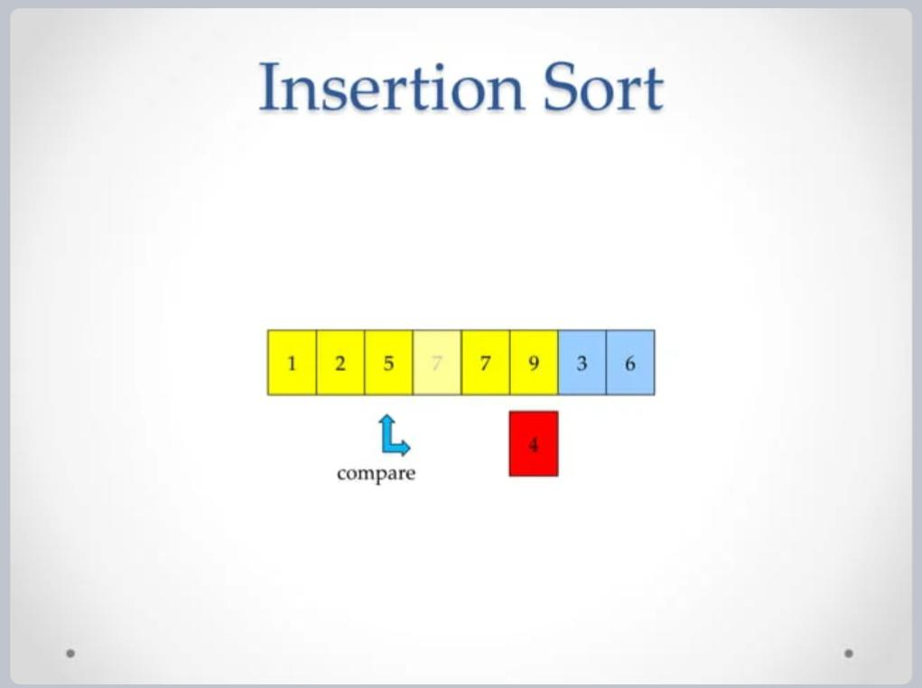

Slide 45
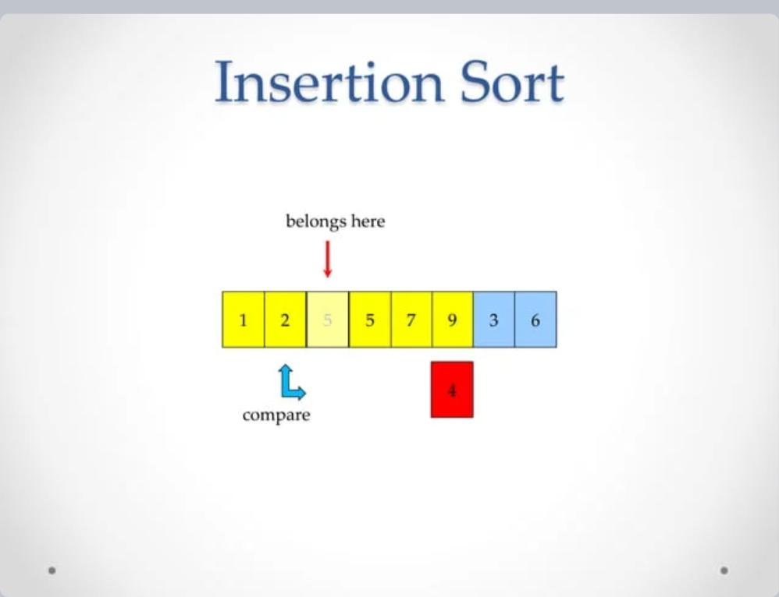

Slide 46
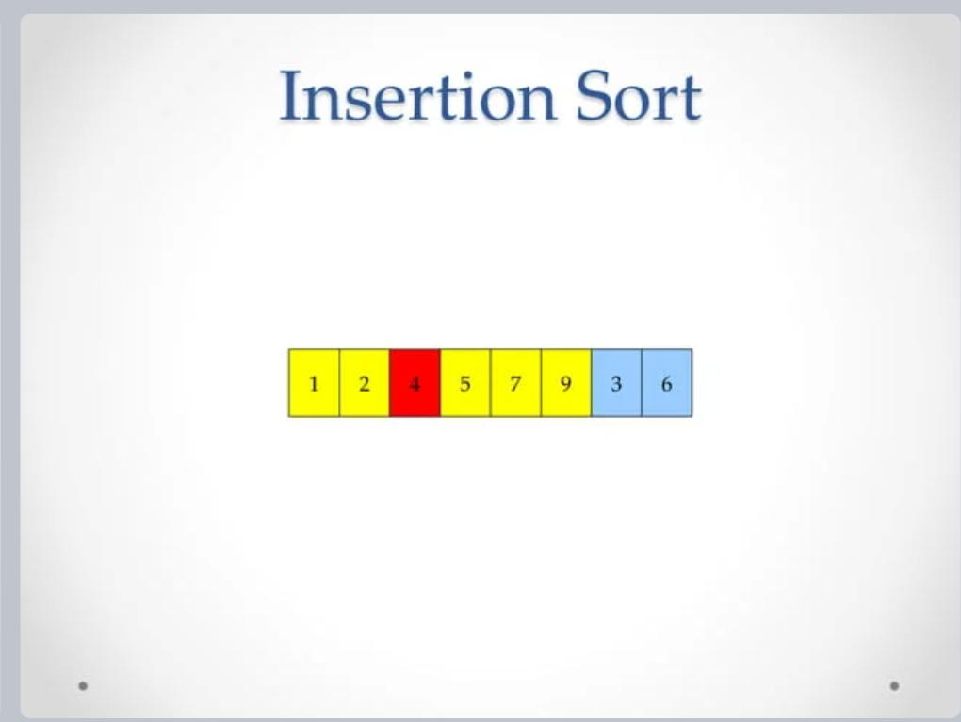

Slide 47
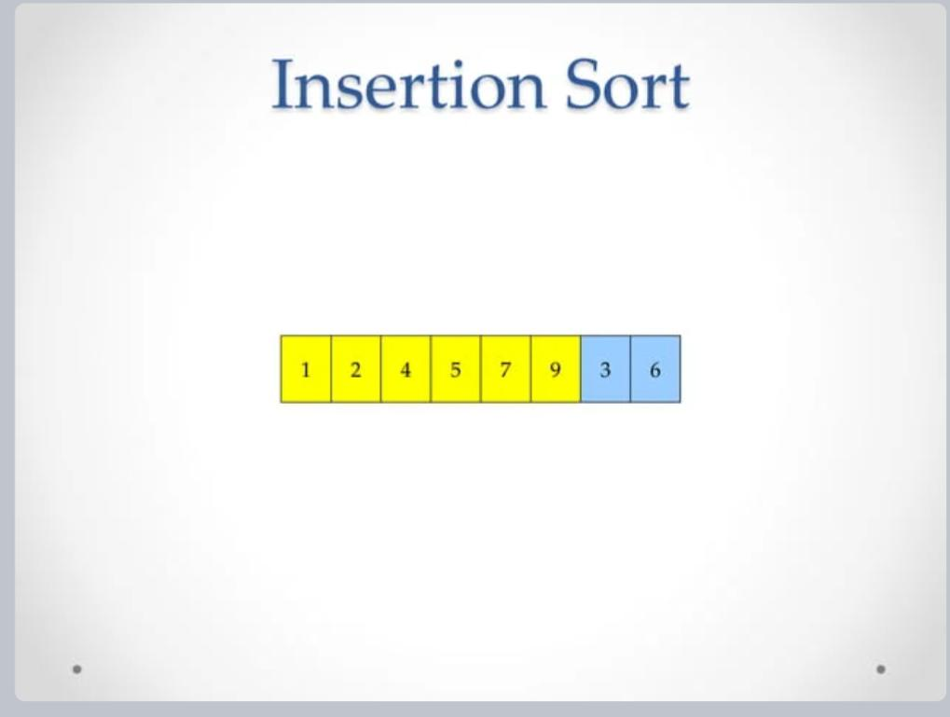

Slide 48
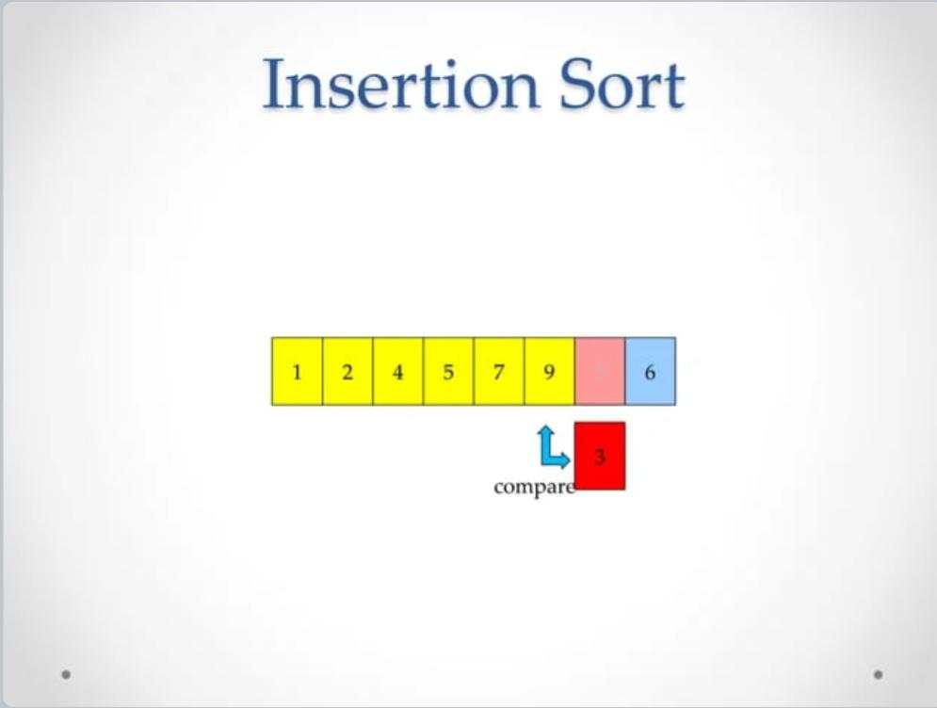

Slide 49
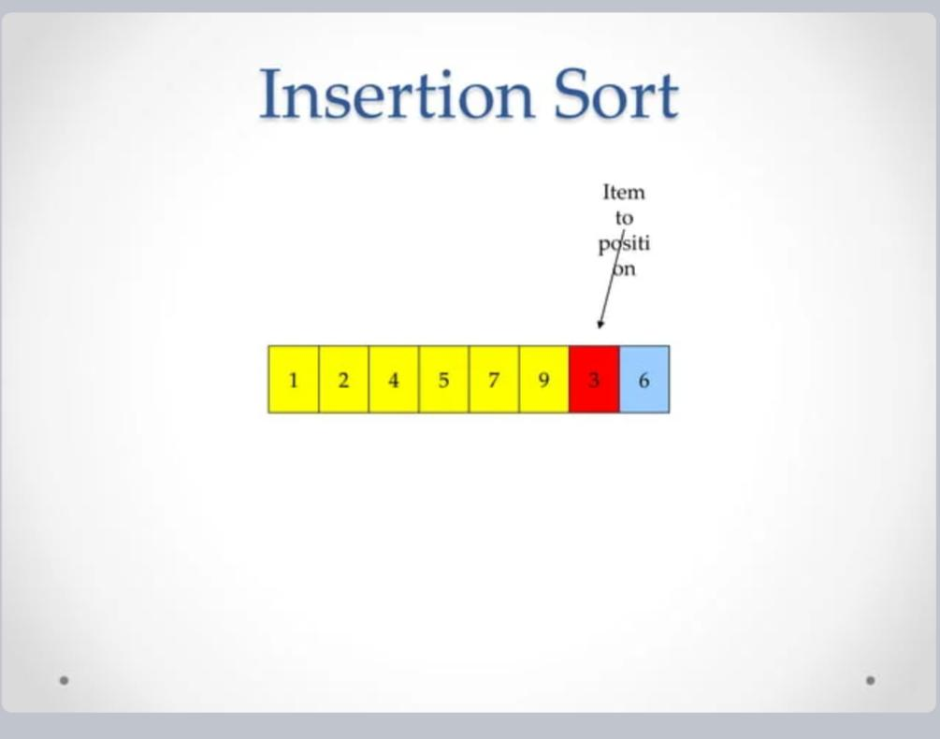

Slide 50
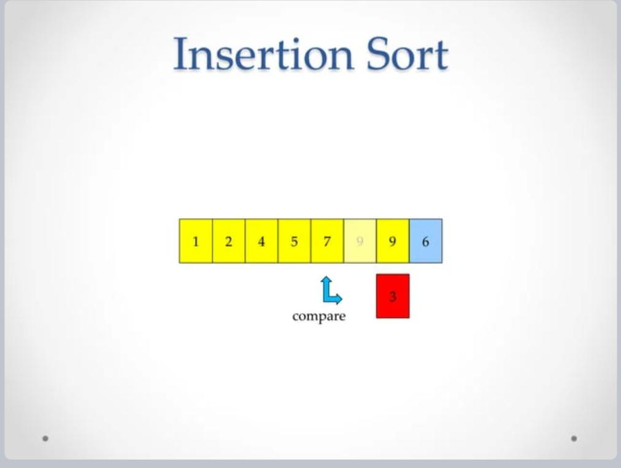

Slide 51
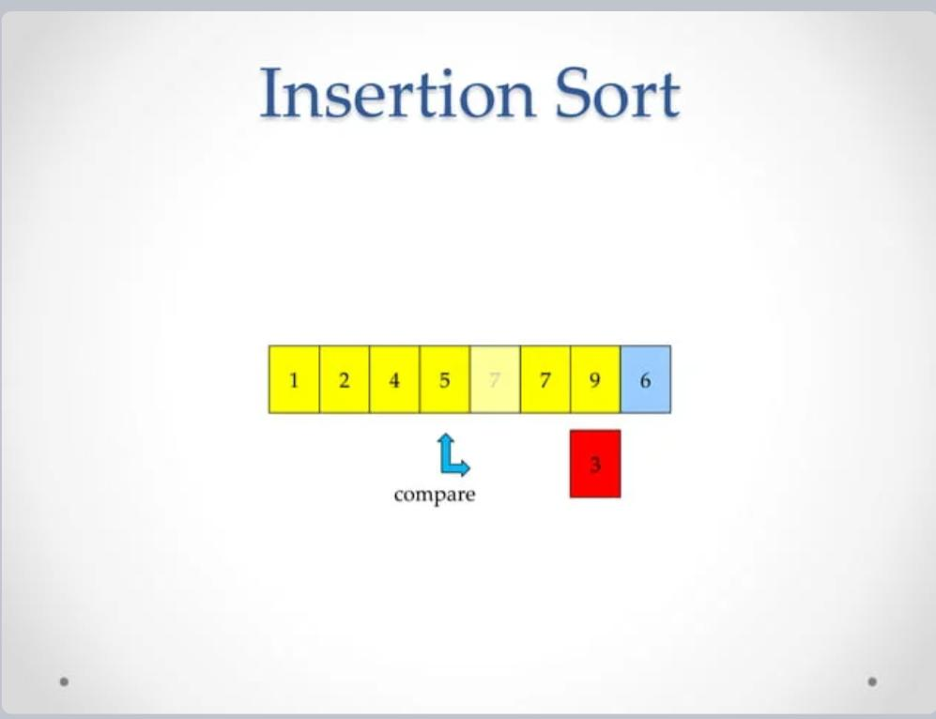

Slide 52
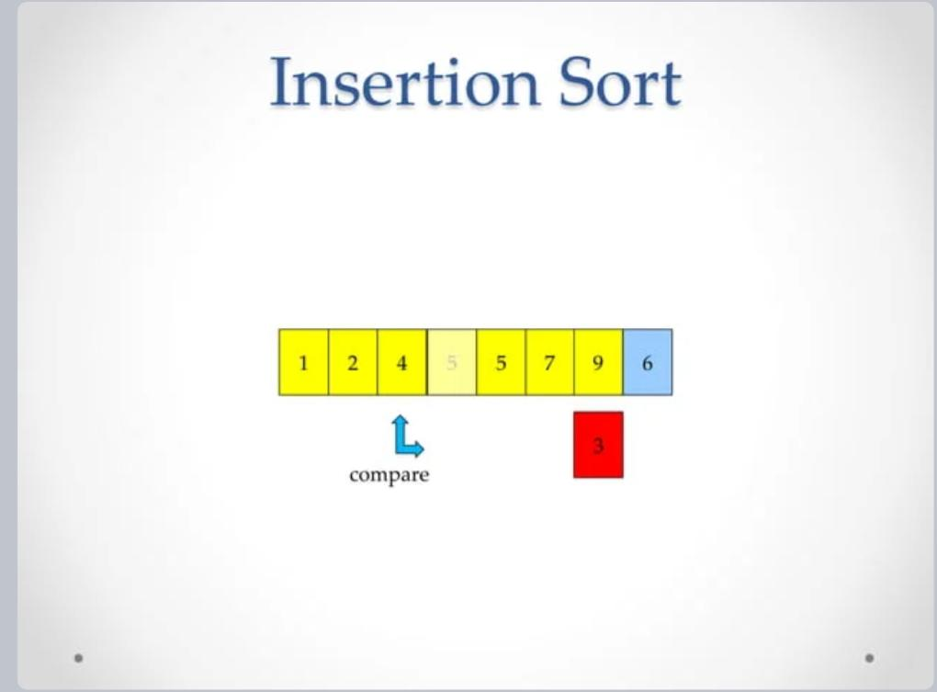

Slide 53


Slide 54


Slide 55


Slide 56


Slide 57


Slide 58


Slide 59


Slide 60


Slide 61


Slide 62


Slide 63
Selection sort
works by repeatedly selecting the smallest (or largest) element from the unsorted portion of the list and moving it to the sorted portion of the list.
This process is repeated for the remaining unsorted portion until the entire list is sorted.

Slide 64

Selection sort
Swapping 1st element with the minimum in array

Slide 65


Selection sort
again traverse the rest of the array in a sequential manner.
After traversing, we found that 12 is the second lowest value in the array and it should appear at the second place in the array, thus swap these values

Slide 66

Selection sort
While traversing, 22 came out to be the third least value and it should appear at the third place in the array, thus swap 22 with element present at third position.

Slide 67

Selection sort
25 is the 4th lowest value hence, it will place at the fourth position.

Slide 68

Selection sort

Slide 69
Selection sort
Selectionsort(a[],n)
Input: An unsorted array a[], n is the no.of elements
Output: a sorted array DS: Array
Algorithm 1: Start 2. i=0 3. while i<n-1 do 1. j=i+1
2. small=i

Slide 70
3. while j<n do
1.if a[small]>a[j]
1. small=j
2.end if
3. j=j+1
4. end while
5. if i!=small
1. temp=a[i]
2. a[i]=a[small]
3. a[small]=temp
6.end if
7. i=i+1
4. end while
5. stop

Slide 71
Merge sort
follows the strategy divide and conquer method
given base array is divided into two sub lists
These 2 sub lists is again divided into 4 sublists.
process is continued until subsists contain single element.
Then repeatedly merge these two sub lists to a single sub list. So that a sorted array is created from sorted sub lists.
process continues until a sub list contains all the elements that are sorted.

Slide 72

Merge sort

Slide 73

Merge sort

Slide 74

Merge sort

Slide 75

Merge sort

Slide 76
Merge sort
Algorithmmergesort(start,end) 1.start Algorithm
1.start
2. if(start!= end)
1. mid=(start+end)/2
2.mergesort(start,mid)
3.mergesort(mid+1,end)
4. merge(start,mid,end)
3. end if
4.stop

Slide 77
Merge sort
Algorithm for merge Merge(start,mid,end)
1. i=start
2. j=mid+1
3. k=start
4. while i<=mid and j<= end do
1. if a[i]<=a[j]
1.temp[k]=a[i]
2. i=i+1
3. k=k+1
2. Else
1.Temp[k] =a[j]
2. J=j+1
3. k=k+1
3. end if
5.end while

Slide 78
Merge sort
2. While i<=mid do 1.temp[k]=a[i] 2. i=i+1 3. k=k+1 7. end while 8. While j<=end 1.Temp[k]=a[j] 2. j=j+1 3. k=k+1 9. end while 10. k=start 11. while k<=end 1.a[k]=temp[k] 2. k=k+1 12.end while 13.stop

Slide 79
Quick sort
Quick sort algorithm basically takes the following steps
1.Choose a pivot element(the pivot element may be in any position).
Normally first element is chosen as pivot
2.Perform partition function in such a way that all the elements
which are lesser than pivot goes to the left part of the array and all the
elements greater than pivot go to the right part of the array. The partition
function also places pivot in exact position.
3. Recursively perform quick sort algorithm in these two sub arrays

Slide 80
Quick sort
Quicksort(lb,ub)
Algorithm
1.start
2.if lb<ub
1.loc=partition(lb,ub)
2.quicksort(lb,loc-1)
3.quicksort(loc+1,ub)
3. end if
4. stop

Slide 81
Quick sort
Algorithm for partition Partition(lb,ub)
1. pivot=a[lb]
2. up=ub
3. down=lb
4. while down< up
1.while pivot>=a[down] and down<=up
1.down=down+1
2. end while
3. while a[up]>pivot
1.up=up-1
4. end while
5. if down< = up
1. swap(a[down], a[up])
6. end if
5. end while
6. swap(a[lb],a[up])
7. return up
8. stop

Slide 82

Quick sort

Slide 83

Quick sort

Slide 84

Quick sort

